Slide 1
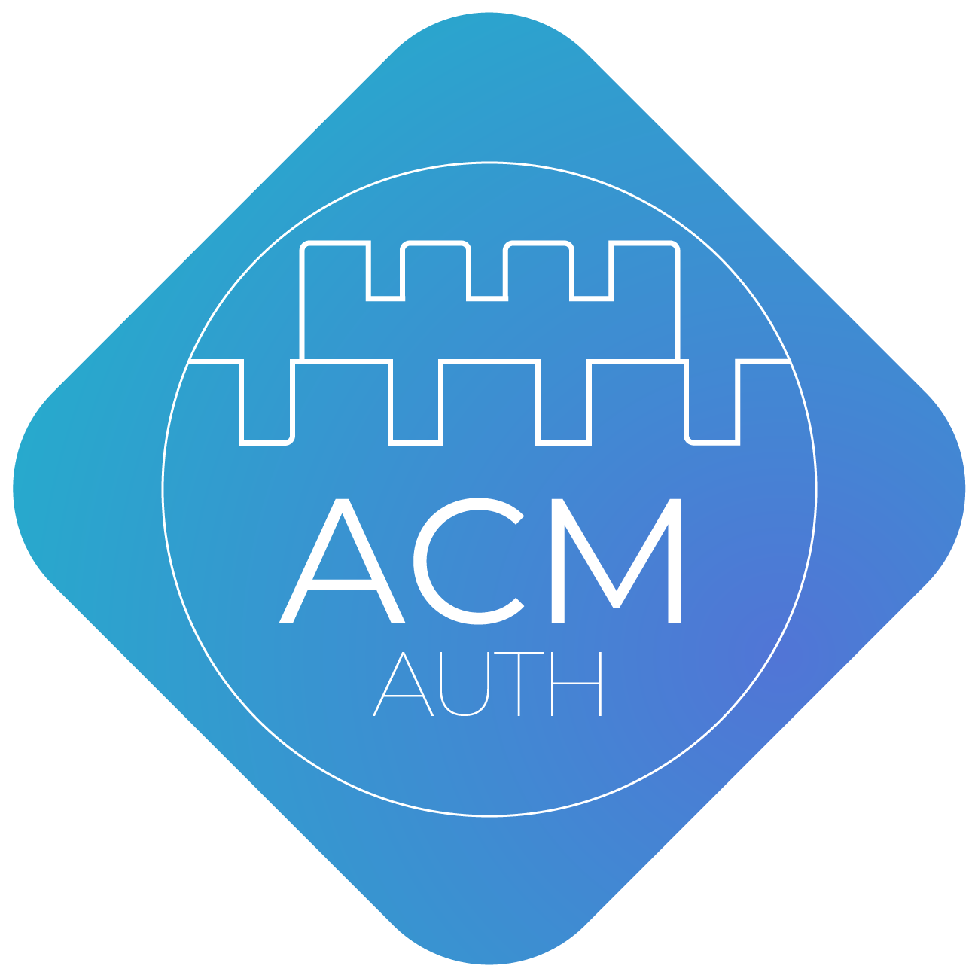

Mobile Development

Slide 2

Mobile Development
Mobile application development is the process of creating software applications that run on a mobile device such as a phone or a table
All apps targeted toward a particular mobile platform are known as native apps, the main purpose for creating such apps is to ensure best performance for a specific mobile operating system

Slide 3
ACM Mobile Development Team
The team was founded in 2020
Aim is the introduction to design and development of Android applications running on smartphones, tablets and other mobiles devices

Slide 4
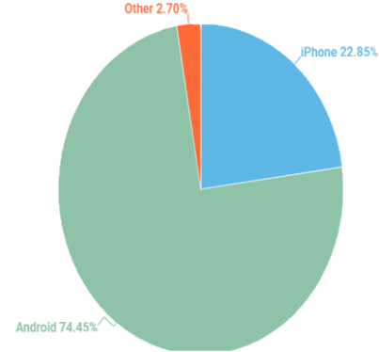
Why Android Development?
Open-source operating system
Compatible with more devices
Booming Job Prospects
Easier to Learn - Lower Development Cost
Development on any computer??
Easily publish to the Google Play Store

Slide 5
What will we do in the team?
Learn the basics for developing native mobiles apps using Java
Design the user interface of mobile applications
Use appropriate integrated development environments (eg Android Studio) for developing mobile applications
Create small projects through the tutorials
Enjoy the process and have fun!

Slide 6
Thank you! Any questions ?
Νικόλας Πέτρου nikopetr@csd.auth.gr

